Slide 1
Sentiment Analysis of Product Reviews
By Cole Landolt

Slide 2
Objective
Use natural language processing (NLP) to analyze the sentiment (positive or negative) of Amazon food product reviews
Compare the different words that constituted positive and negative reviews
Compare the model’s results to the ratings that customers gave the product (out of 5 stars)

Slide 3
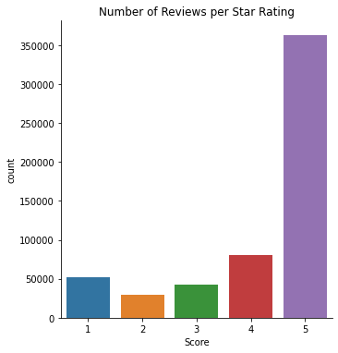
Data Exploration
Out of the 568,454 reviews, more than half of them were 5 stars

Slide 4
Modeling
To analyze the sentiment of each review, I used a transformer model
Transformer models (GPT, BERT, BART, T5, etc.) are large language models trained on large amounts of text in a self-supervised fashion and can be fine-tuned for specific tasks in a supervised way.
The model I used is called distilbert-based-uncased-finetuned-sst-2-english and is a distilled version of the BERT base model that is finetuned on the Stanford Sentiment Treebank (SST-2) dataset for sentiment analysis
The model is 60% faster, 40% lighter, and still retains 97% of BERT’s performance

Slide 5
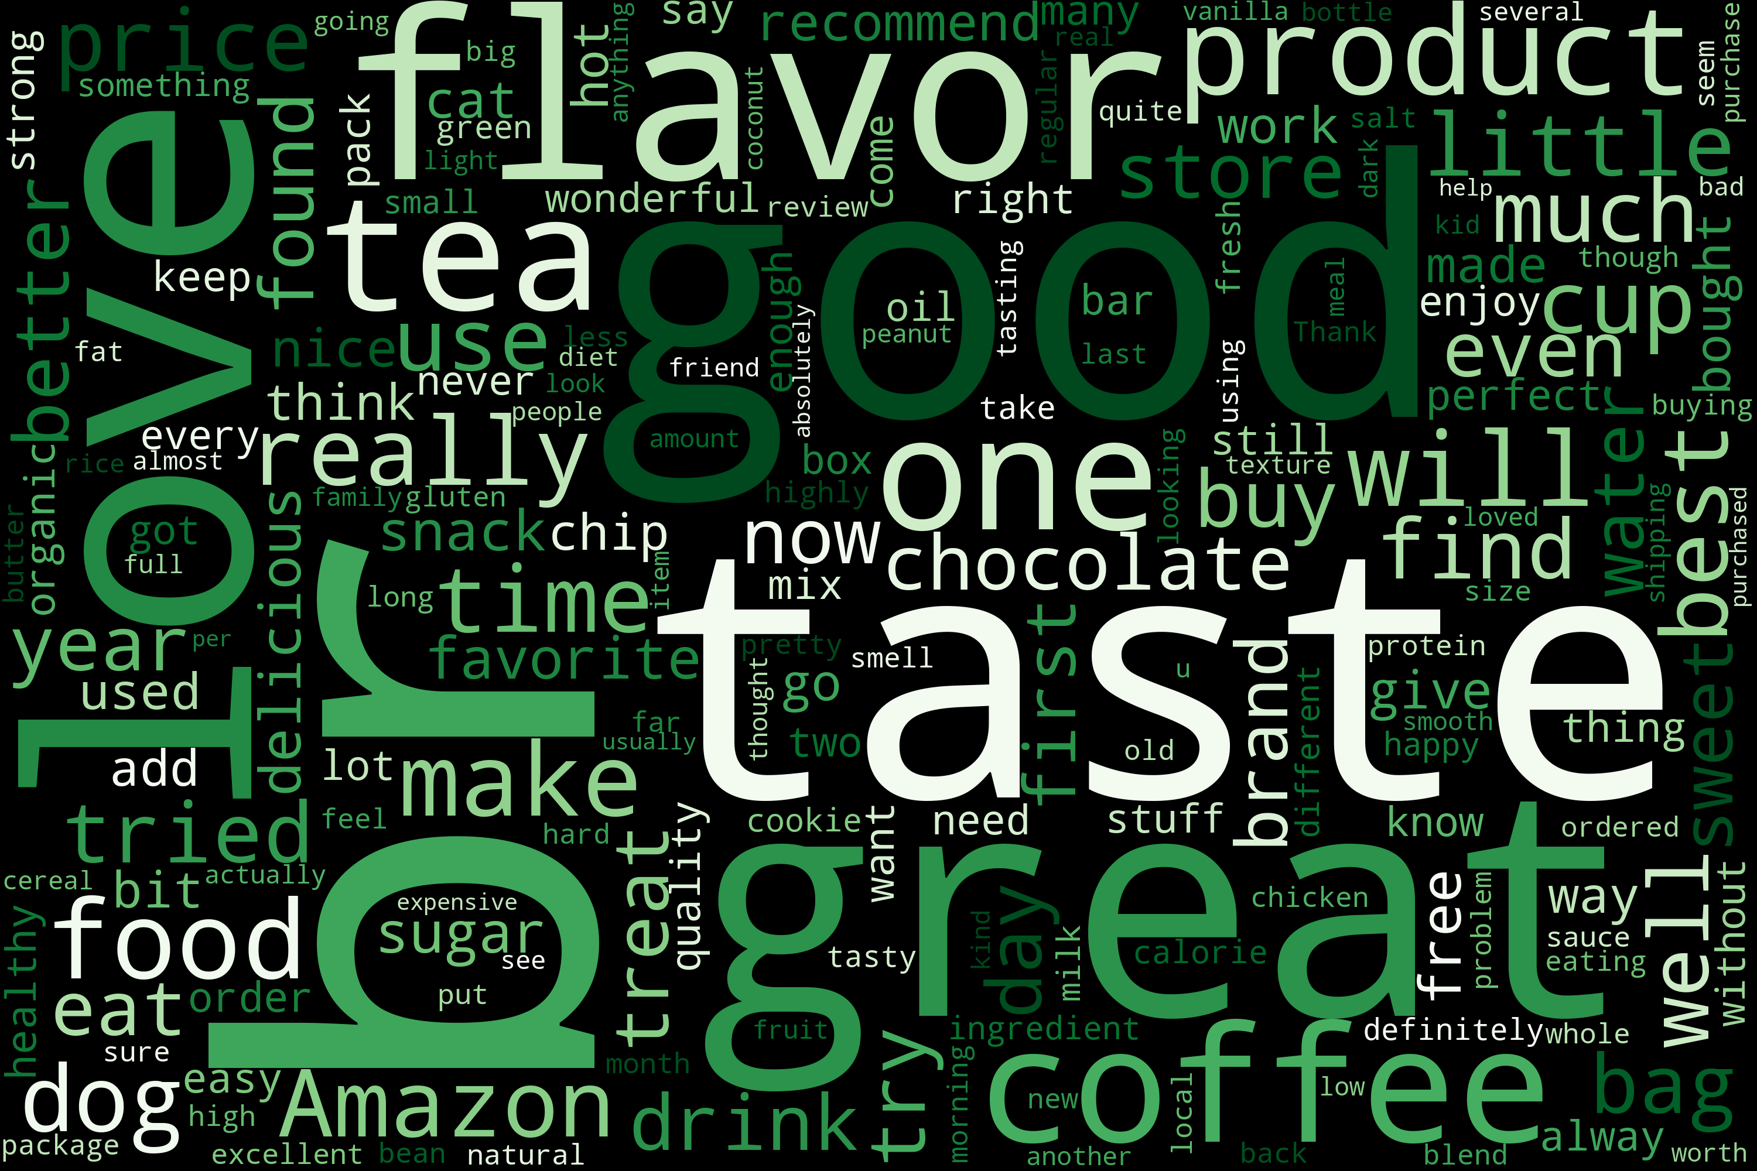
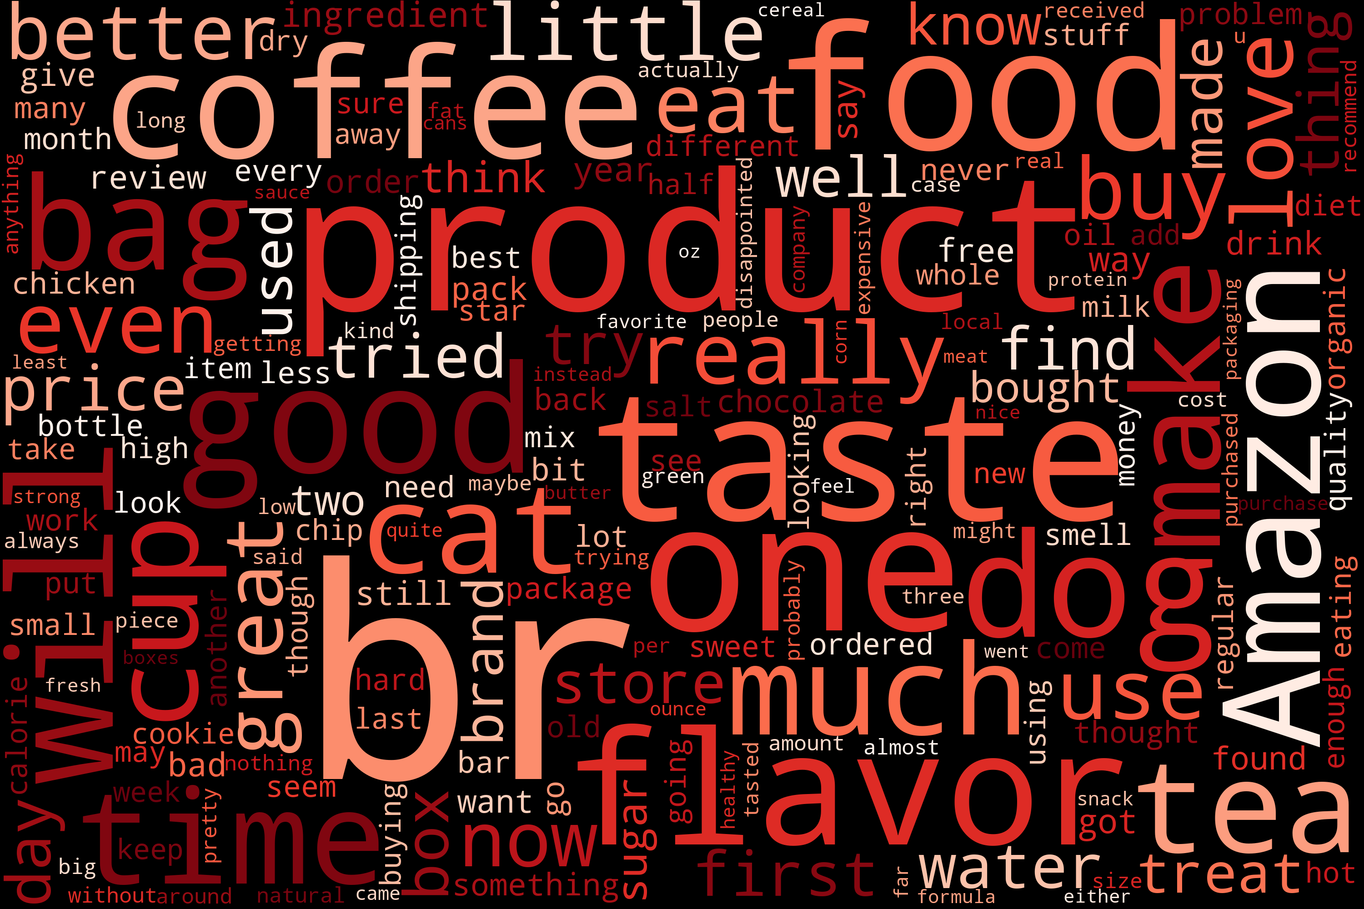
Results
Both Word Clouds share a category of words that likely describe the products reviewed, such as coffee, flavor, product, and food
The Word Cloud of positive reviews has several words that one might expect to find, such as good, great, and love
The Word Cloud of negative reviews does not contain as many words with negative connotations as one might expect.
Positive Reviews
Negative Reviews

Slide 6
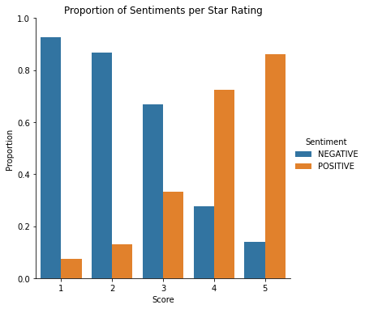
Results
The positive and negative sentiments are distributed amongst each Star Rating as one might expect:
  Very small proportions of 1- and 2-star ratings have positive reviews
  Very small proportions of 5-star ratings have negative reviews
  3- and 4-star ratings have larger minority proportions of positive and negative reviews, respectively

Slide 7
Conclusion
Sentiment analysis on product reviews adds more information about the nature of the reviews in tandem with the star rating
The distilbert transformer model, finetuned for sentiment analysis, is effective at extracting the sentiment of text sequences
Although this dataset did not offer an opportunity to do so, text sentiments can be added as a useful feature to a predictive model

